Slide 1


Slide 2
Contents
Introduction
The Lounge Problem
Design principles
The Strategy Pattern
Summary

Slide 3
Let’s give Inheritance a try!

Slide 4
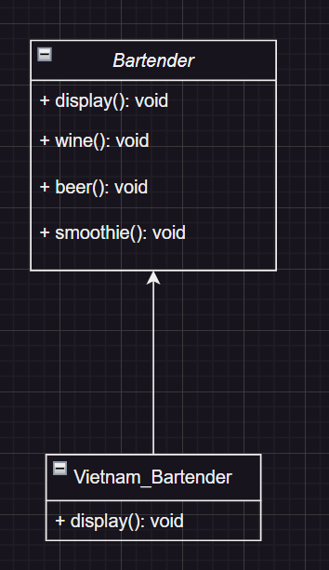

Slide 5
How about an interface?
Notes:
An interface describes the behavior or capabilities of a C++ class without committing to a particular implementation of that class.

Slide 6
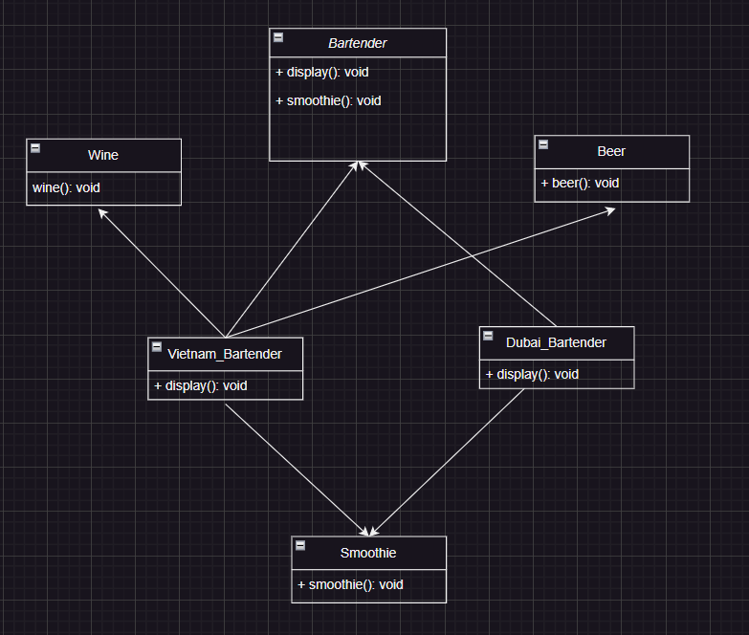

Slide 7
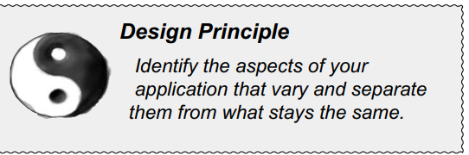
Notes:
In other words, if you’ve got some aspect of your code that is changing, say with every new requirement, then you know you’ve got a behavior that needs to be pulled out and separated from all the stuff that doesn’t change. Here’s another way to think about this principle: take the parts that vary and encapsulate them, so that later you can alter or extend the parts that vary without affecting those that don’t.
As simple as this concept is, it forms the basis for almost every design pattern. All patterns provide a way to let some part of a system vary independently of all other parts

Slide 8







Notes:
In other words, if you’ve got some aspect of your code that is changing, say with every new requirement, then you know you’ve got a behavior that needs to be pulled out and separated from all the stuff that doesn’t change. Here’s another way to think about this principle: take the parts that vary and encapsulate them, so that later you can alter or extend the parts that vary without affecting those that don’t.
As simple as this concept is, it forms the basis for almost every design pattern. All patterns provide a way to let some part of a system vary independently of all other parts

Slide 9
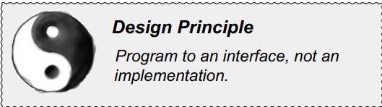

Slide 10
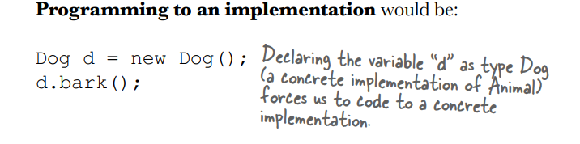
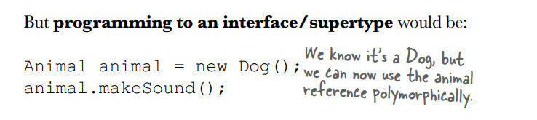

Slide 11
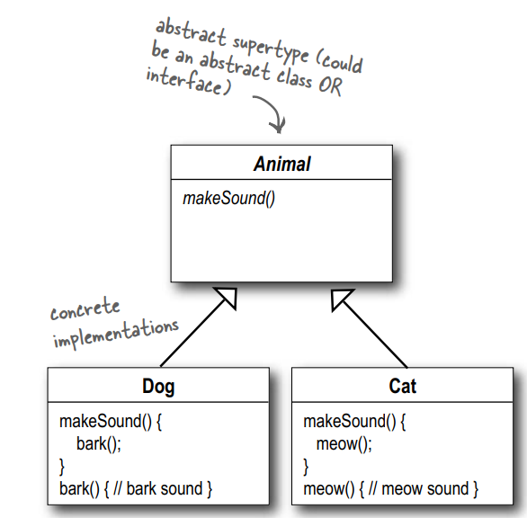

Slide 12
Strategy Pattern

Slide 13
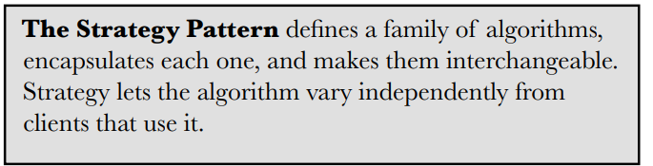
DEFINITION OF STRATEGY PATTERN

Slide 14
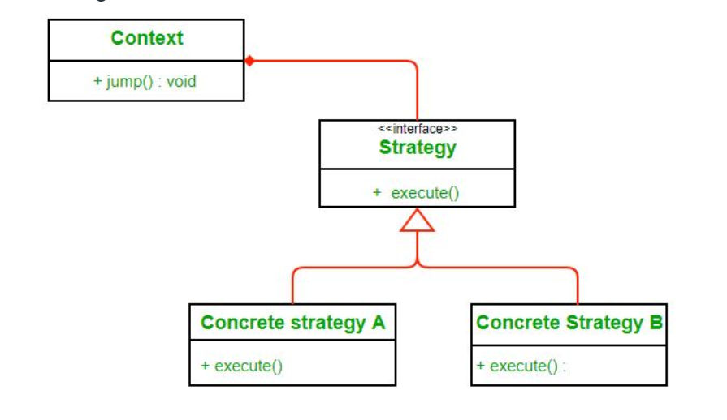
STRUCTURE

Slide 15
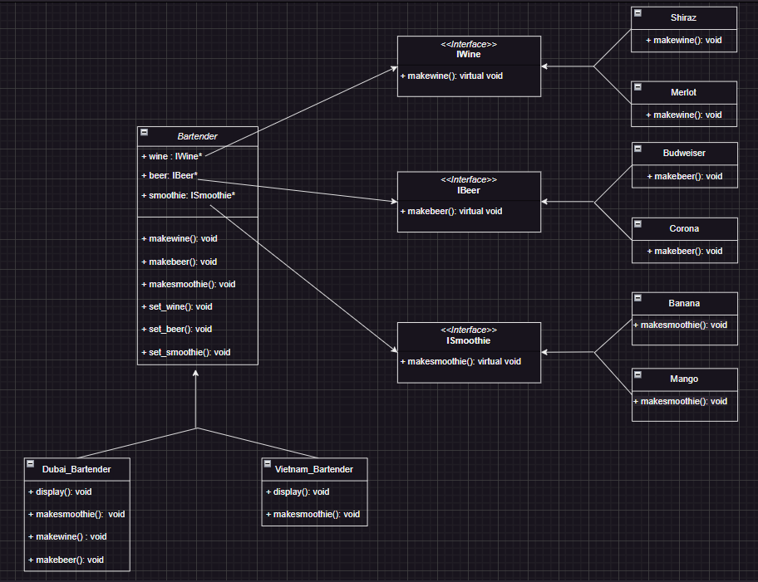

Slide 16
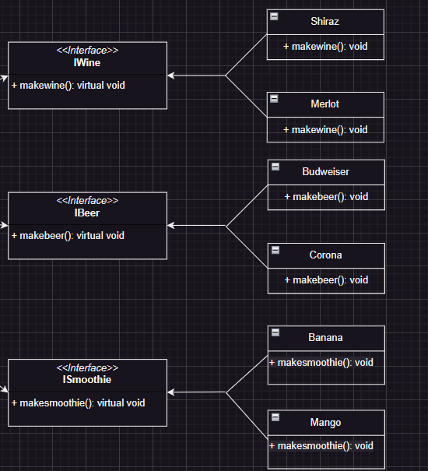

Slide 17
DEFINITION OF STRATEGY PATTERN

